Slide 1
Cyber Threat Intelligence
(U) CYBER INTELLIGENCE PREPARTION OF THE OPERATIONAL ENVIRONMENT (CIPOE) TEMPLATE
Briefer: Rank & Last Name
Overall Classification:
CAO: DDXXXXMMMYY
Notes:
Updated By: Anthony Jones

Slide 2
(U) Overview
Target Analysis
Courses of Action
Timeline Analysis
Historical Analysis
Tool Analysis
Cyber IPOE
Intelligence Gaps
Data Extracted
Tactics, Techniques & Procedures
World Events
Common Vulnerabilities & Exposures
Notes:
(U)

Slide 3

(U) Historical Analysis
(U) Should include a timeline of attacks within a 1–3-year span with the most recent to oldest
Date & Name of attack
Key details: Who, what, when, where, why, how?
(U) Example: 14NOV19: APT 29 Phishing Campaign
Who is the threat? APT 29
What occurred? APT 29 compromised the email server of a hospital and the corporate website of a consulting company
When did it happen? 14 November 2019
Where did it happen? Hosted on a page made to look like another Department of State Public Affairs official's personal drive, and used a legitimate Department of State form as a decoy.
Why did it happen? In order to use their infrastructure to send phishing emails to gain information from compromised networks.
How was the attack employed? The phishing emails were made to look like secure communication from a Public Affairs official at the U.S. Department of State. The attacker used unique links in each phishing email to download a ZIP archive that contained a weaponized Windows shortcut file, launching both a benign decoy document and a Cobalt Strike Beacon backdoor, customized by the attacker to blend in with legitimate network traffic.
(U) Include any relevant graphics
Notes:
(U)

Slide 4
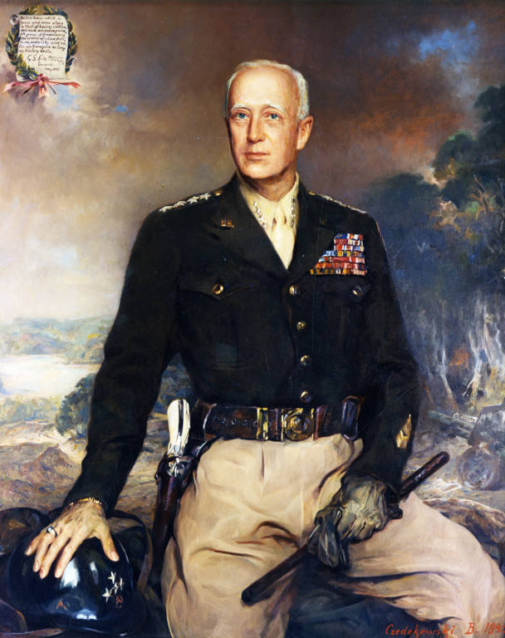
(U) Courses of Action
(U) Most likely course of action
Should be based on historical TTPs, most commonly used effects in light of target and similar circumstances
Key details: Who, what, when, where, why, how?
(U) Most dangerous course of action
Should be based on historical TTPs, what would cause the most detriment to target of opportunity
Key details: Who, what, when, where, why, how?
(U) Example: APT 29’s most likely COA is employing spear phishing emails to lower ranking airmen to gain access to and compromise the 185th COS, VA ANG’s network. The hacker group will likely impersonate an official government agency with links to zip files containing malicious Windows shortcuts that will deliver a malware. Subsequently, they will create a backdoor on 185th’s network and likely access sensitives files and/or escalate privileges to remain on the network undetected to securely retrieve data deemed significant to them within the next two weeks.
(U) Include any relevant graphics
Notes:
(U)

Slide 5

(U) Intelligence Gaps
(U) Should be any crucial information that was not able to be found. Steps to acquire missing information should be conducted as well. An analyst should never stop at “I don’t know,” but rather at “I performed x-action to address said intelligence gap.”
(U) Example: APT 29 infiltrated our network and extracted some sensitive data from us. We currently we have no specific action taken identified, so an inquiry to the investigation team was sent requesting a technical report for the incident following the close of the investigation. We should be provided with that information within two weeks.
(U) Include any relevant graphics
Notes:
(U)

Slide 6

(U) Data Extracted
(U) Should include any documents that were extracted, the location of where the documents were taken from, the computer and whose it was, the time and date, and the server, individual and location to where the data was sent and how
(U) Example:
Two documents were taken by a hacker aligned with APT 29 On 03JUN2019 at 1200L from computer 23/Anthony Jones’ computer (123.4.53.1.0). He went to folder “6. Black Demon” within this filepath: R:\CYO\Intel\SECTION C. The documents extracted were as follows: filthyjones.ppt and grandpajones.csv. The documents were sent to filthyrusian.vly (312.2.45.1.3) on 03JUN2019 at 1205L via Anthony Jones’ email (Anthony.jones.66@msn.com) to a disconnected Gmail account (filthy.rus@gmail.com).
(U) Include any relevant graphics
Notes:
(U)

Slide 7
(U) Common Vulnerabilities & Exposures
(U) Common Vulnerabilities & Exposures
Some site like the Vulnerability Management Tool Data Repository that will have information. For the Air Force, it is hosted by the AFIN Mission Assurance Center. This site and its associated pages acts as the "living" centralized repository for all Vulnerability Management data (ACAS, HBSS, others as necessary), Reports and Assessments, Prioritization Lists and Hot Topics, as well as the most up-to-date references and authoritative documents.
(U) Common Vulnerabilities & Exposures (CVEs)
CVE can help cyber operators develop a clear and detail picture of the threats to the network that they are defending before performing surveying the terrain.

Slide 8
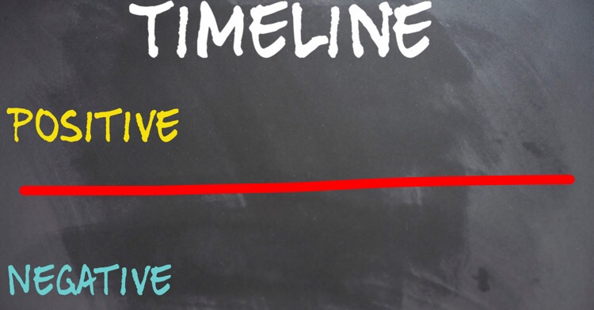
(U) Timeline Analysis
(U) Times New Roman 16 pt for each paragraph
Times New Roman 14 pt for each sub point
Times New Roman 10-12 for each sub-sub point
(U) Times New Roman 16 pt for each paragraph
Times New Roman 14 pt for each sub point
Times New Roman 10-12 for each sub-sub point
(U) Times New Roman 16 pt for each paragraph
Times New Roman 14 pt for each sub point
Times New Roman 10-12 for each sub-sub point
(U) Times New Roman 16 pt for each paragraph
Times New Roman 14 pt for each sub point
Times New Roman 10-12 for each sub-sub point
(U) Include any relevant graphics
(U) Assessment: Times New Roman 12 pt
Notes:
(U)

Slide 9







(U) Timeline Analysis
(U) Should include a graphic presentation (via power point or analyst notebook) of everything that took place during the attack to include:
Date of each occurrence
Time stamps
Name of individuals involved
Computer (IP address)
Location (server/network/physical address)
filthyrusian.vly 312.2.45.1.3
062100ZJUN19
from: f.jones@msn.com to: filthy.rus@gmail.com
Extracted 2 docs:
filthyjones.ppt &
grandpajones.csv
Filthy Jones
0721030ZJUN19
opened
062109ZJUN19
Computer 6
123.45.1.2.01
(U) Example: On 06JUN2019, Filthy Russian (312.2.45.1.3) sent a phishing email with malware attached to Filthy Jones at 2100L. Filthy Jones opens the email on the same day at 2109L and infects his computer (#6/123.45.1.2.01). The next day at 2130L Filthy Russian extracts two documents titled: filthyjones.ppt &
grandpajones.csv via Filthy Jones email and sent files to email filthy.rus@gmail.com.
Notes:
(U)

Slide 10

(U) Target Analysis
(U) Target Research
Research the organizations, businesses and company targeted for:
Information exfilled (if available)
System affected
Personnel involved (CEO, vice president…ect)
(U) Is the target attack on this level often?
Sometimes the frequency of the attacks can paint a picture of the attacker(s) research into the target or display “holes” in the organization’s network defense
(U) Research who the target associates with
Some targets are attacked because of their affiliation to countries, other organizations, political stances…ect
Times New Roman 10-12 for each sub-sub point
(U) Include any relevant graphics
(U) Comments: Start your research on a micro level and finish on a macro level. Clues to the identity of the attacker(s) may not be apparent solely researching the target attack but may be found researching beyond the target itself.
Notes:
(U)

Slide 11

(U) Tool Analysis
(U) Give an overview of the tools that the APT is employing
Operations View- how are they employing the tool, how is the tool being used to hide or extract data?
Intelligence view- of the data taken with the tool, what is its value and how can it be useful to the enemy?
Percent- what percent of the year is the APT using their tool(s)?
*A few important notes:
Since Early to Mid 2020, performing attribution has become more difficult because a hacker groups have sold, they tools on the Dark Web to whoever has the money to purchase them.
Additionally, some Advanced Persistent Threat Groups (APTs) have “Hacker for Hire” programs. For example, North Korea have a specific team of individuals who was used their own tools and TTPs to attack a target for the financial groups’ choosing. This makes it difficult identify “ALL” the individuals responsible for the attack.
With the availability of Artificial Intelligence (AI), attackers can use to improve on the limitation of an existing tools to enhance the effectiveness. Additionally, some attackers will go as far as to create a Virtual Network of the victim’s Physical Network to test newly improvement tools before deployment.
(U) Include any relevant graphics
Notes:
(U)

Slide 12
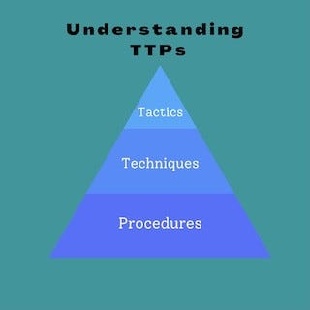
(U) Tactics, Techniques & Procedures
(U) Times New Roman 16 pt for each paragraph
Times New Roman 14 pt for each sub point
Times New Roman 10-12 for each sub-sub point
(U) Times New Roman 16 pt for each paragraph
Times New Roman 14 pt for each sub point
Times New Roman 10-12 for each sub-sub point
(U) Times New Roman 16 pt for each paragraph
Times New Roman 14 pt for each sub point
Times New Roman 10-12 for each sub-sub point
(U) Times New Roman 16 pt for each paragraph
Times New Roman 14 pt for each sub point
Times New Roman 10-12 for each sub-sub point
(U) Include any relevant graphics
(U) Assessment: With the deployment of AI to the general public, TTPs will expand exponentially, however; AI may be used create a new database of TTPs based on TTPs identified was been create by AI.
Notes:
(U)

Slide 13
Cyber Threat Intelligence
Questions?
Briefer: Rank & Last Name
Overall Classification:
CAO: DDXXXXMMMYY
Notes:
(U)

